Slide 1
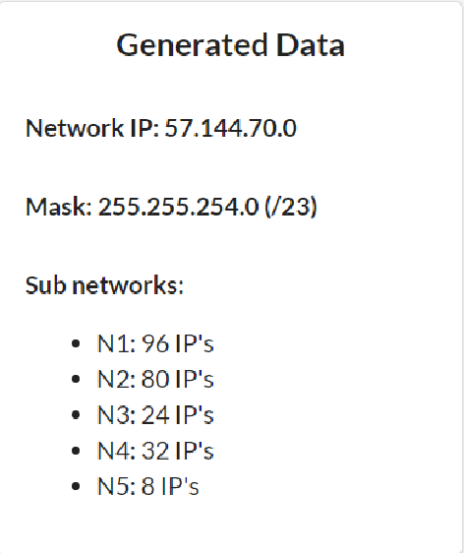
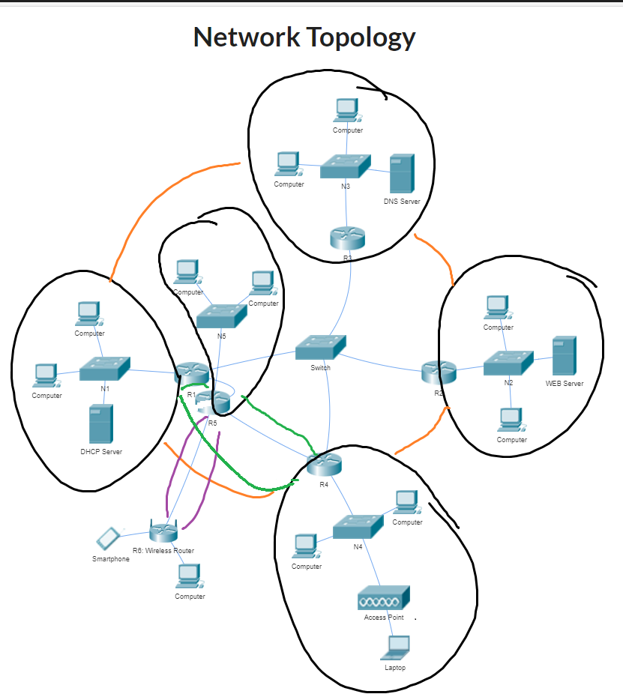

N3
x=32-23=9 2^9=512
N5
N2
N1
What other networks do we need?
N1324: 4 IP’s
N15: 2 IP’s
N45: 2 IP’s
N5w: 2 IP’s
N4

Slide 2
/23 → 512 IP addresses
n devices (IP) + 1 router + 1 NA + 1 BA → n+3
N1: 96+3=99 < 128 =2^7 7 zeros, 32-7=25 ones /25
N2: 80+3=83 < 128=2^7 /25
N3: 24+3=27 < 32=2^5 /27
N4: 32+3=35 < 64=2^6 /26
N5: 8+3=11 < 16=2^4 /28
N1324: 4+2=6 < 8=2^3 /29
N15: 2+2=2 < 4=2^2 /30
N45: 2+2=2 < 4=2^2 /30
N5w: 2+2=4 < 4=2^2 /30
128+128+64+32+16+8+4+4+4=388<512

Slide 3
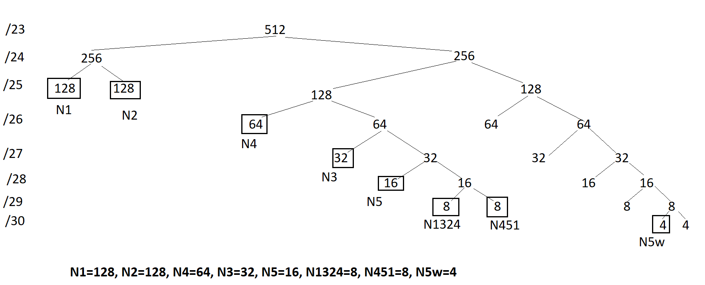


Recursive network split using a binary tree
8
4
4
N15
N45

Slide 4
Recursive network split using split intervals
[70.0………… 70.255 71.0…………………………………………………………………………………………………………………………………………………71.255]
[0……………………255][0………………………………………………………………………………………………………………………………………………………….255]
[0…127][128…..255][0………………………………………………………………….127][128……………………………………………………………………….255]
[0…127][128…..255][0………………………63][64………………….…………..127][128………………………………191][192…..…………………….255]
[0…127][128…..255][0………………………63][64…………95][96…..….…127][128…………………………………………………..223][224…….255]
[0…127][128…..255][0………………………63][64…………95][96..111][112……..127][128………………………………………...239][240….255]
[0…127][128…..255][0………………………63][64…………95][96..111][112.119][120.127][128…………………………….…247][248….255]
[0…127][128…..255][0………………………63][64…………95][96..111][112.119][120..123][124..127][128.....…………251][252….255]
*N5w will actually be in the
address interval 71.128 – 71.131,
not the one specified here

Slide 5
Enumerating the networks:
N1=57.144.70.0 /25 R1=70.1 S1=70.2 Mask: .128
N2=57.144.70.128 /25 R2=70.129 S2web=70.130 .128
N3=57.144.71.64 /27 R3=71.65 S3dns=71.66 .224
N4=57.144.71.0 /26 R4=71.1 .192
N5=57.144.71.96 /28 R5=71.97 .240
N1324=57.144.71.112 /29 R1=71.113 R3=71.114 R2=71.115 R4=71.116 .248
N15=57.144.71.120 /30 R1=71.121 R5=71.122 .252
N45=57.144.71.124 /30 R4=71.125 R5=71.126 .252
N5w=57.144.71.128 /30 R5=71.129 Rw=71.130 .252

